Slide 1
STUDENT PERFORMANCE PREDICTION
Machine Learning
Abdelrahman Elkelany
Abd-Elrahman Younes
Nader Naguib
Dr. Mohammed Elmandouh

Slide 2
STUDENT PERFORMANCE PREDICTOR MACHINE LEARNING PROJECT
Project Introduction :
The Student Performance Predictor applies machine learning techniques to predict students’ academic outcomes, including final numerical grades and letter grades (A–F), based on academic and behavioral data.

Slide 3
PROBLEM STATEMENT :
How can student-related data be effectively used to build an intelligent system capable of:
Accurately predicting a student’s final grade Classifying students into appropriate letter-grade categories (A–F)?
Identifying the most influential factors affecting academic success?

Slide 4
DATA PREPROCESSING :
Data preprocessing was performed following standard data science best practices and included the following steps:
Exploratory Data Analysis (EDA) to understand data structure and distributions.
Handling missing values:
Numerical features filled using the median.
Categorical features filled using the mode.
Cleaning categorical text data (lowercasing and trimming whitespace).
Encoding categorical variables using One-Hot Encoding.
Correlation analysis with the target variable (G3).
Splitting the dataset into training and testing sets (80% / 20%) with stratification.

Slide 5
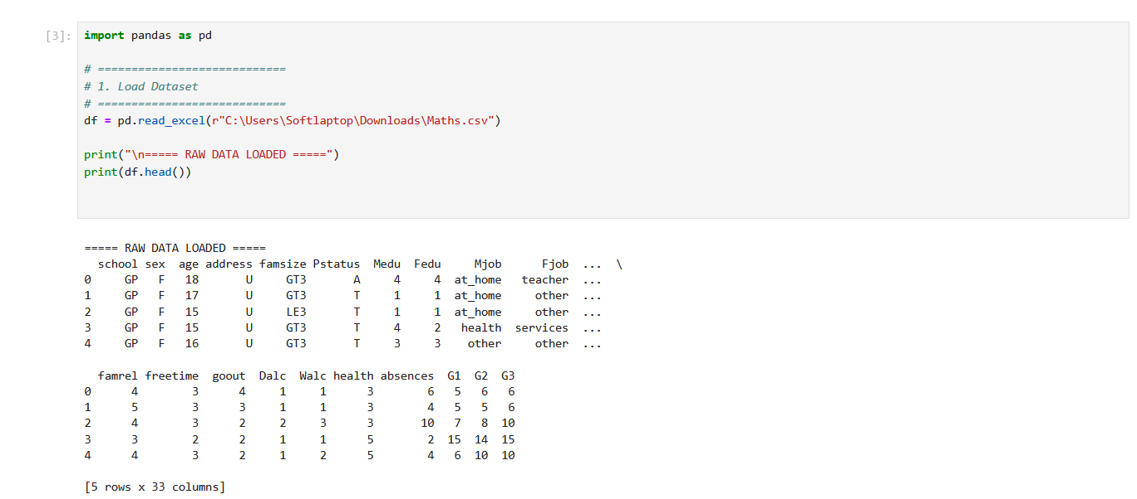
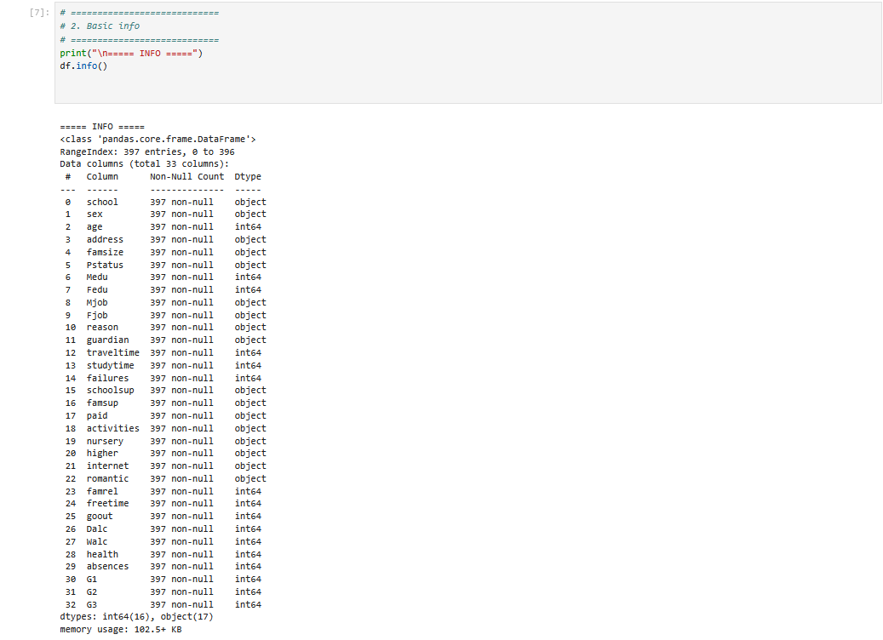
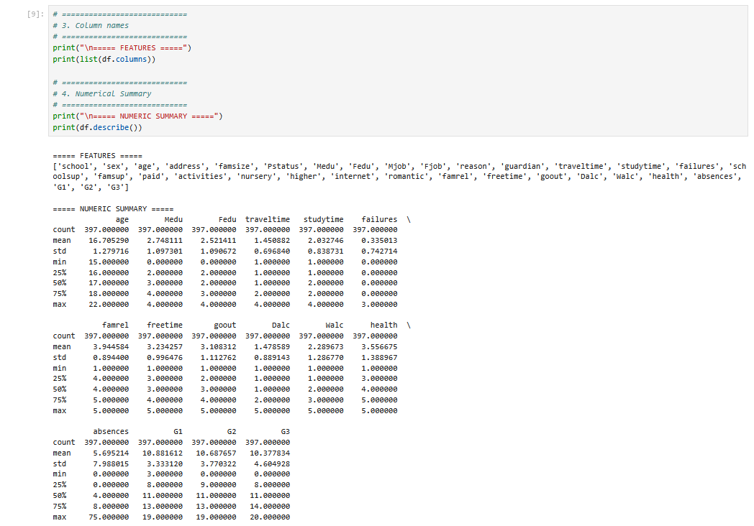
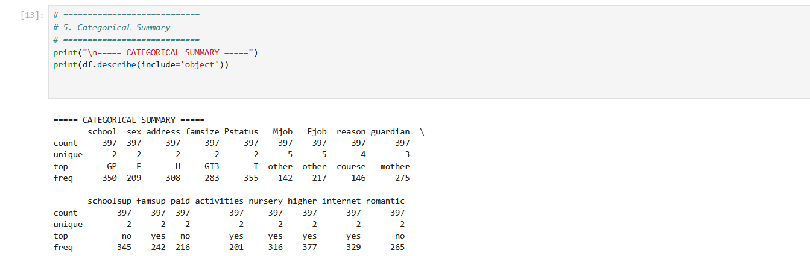

Slide 6
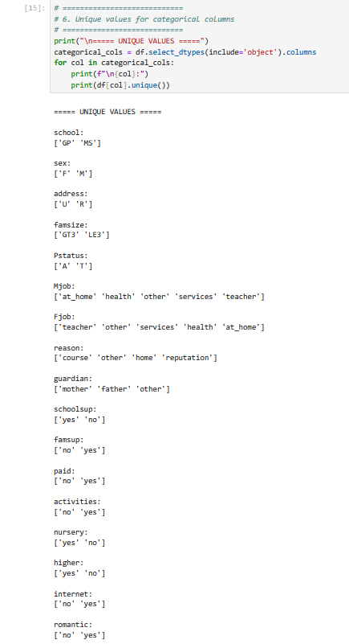
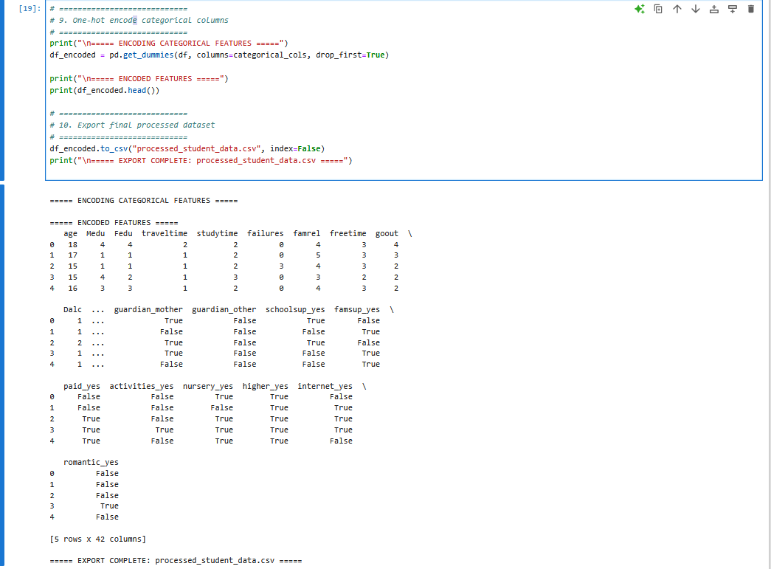
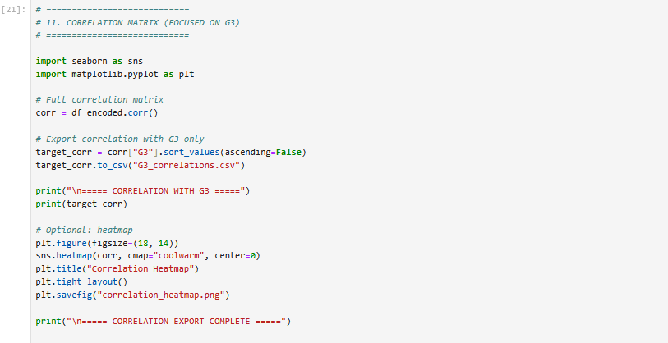

Slide 7
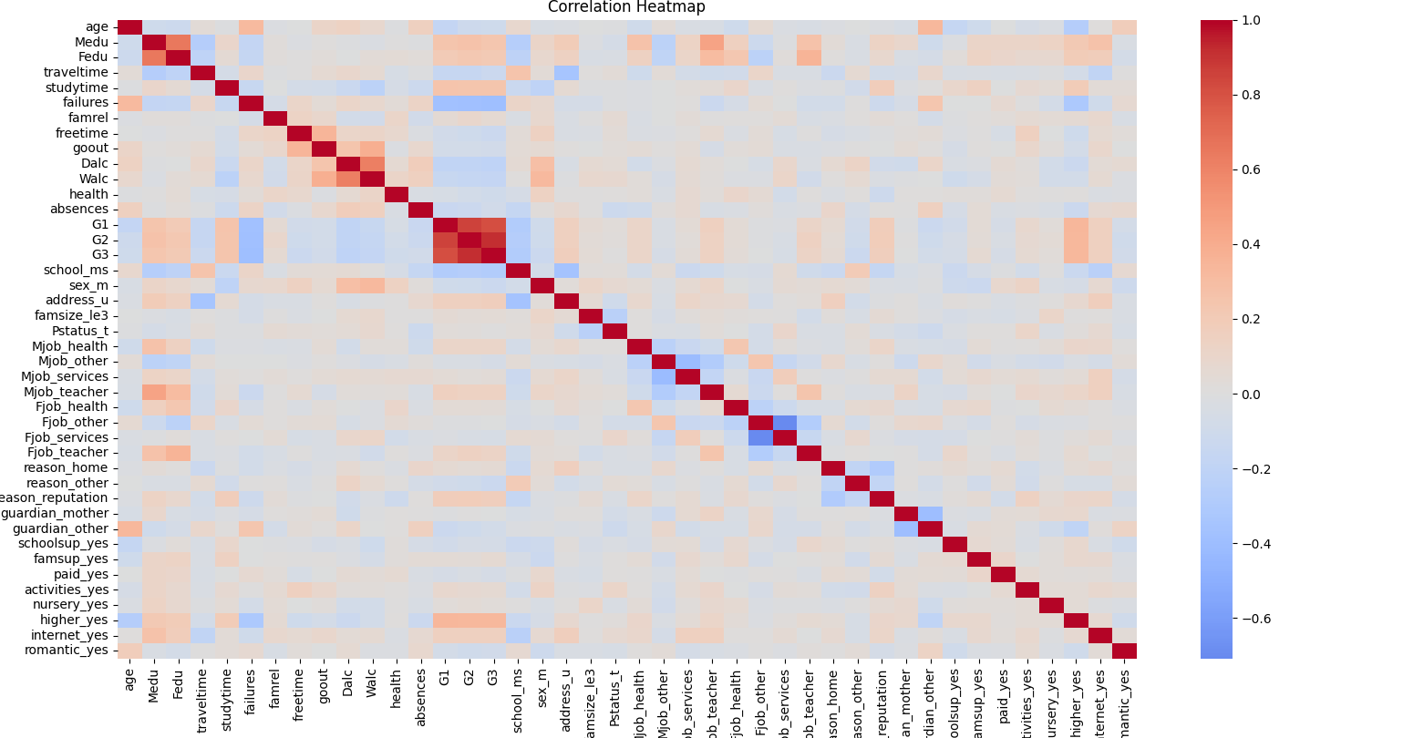

Slide 8
MACHINE LEARNING MODELS USED :
CLASSIFICATION MODELS USED :
Random Forest
XGBoost
Support Vector Machine(SVM)
Regression Models :
Linear Regression
Random Forest
Gradient Boosting

Slide 9
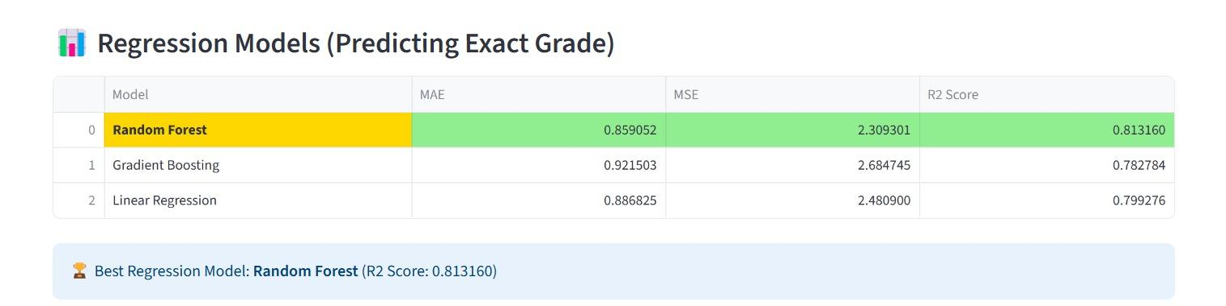
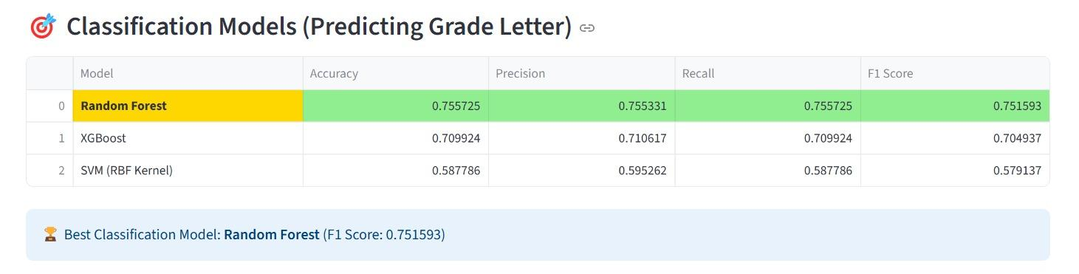

Slide 10
MODEL EVALUATION METRICS
Regression Evaluation Metrics
Mean Absolute Error (MAE)
Mean Squared Error (MSE)
R² Score
Classification Evaluation Metrics
Accuracy
Precision (Weighted)
Recall (Weighted)
F1-Score (Weighted)
Confusion Matrix
Additionally, cross-validation was applied to ensure model robustness and reduce the risk of overfitting

Slide 11

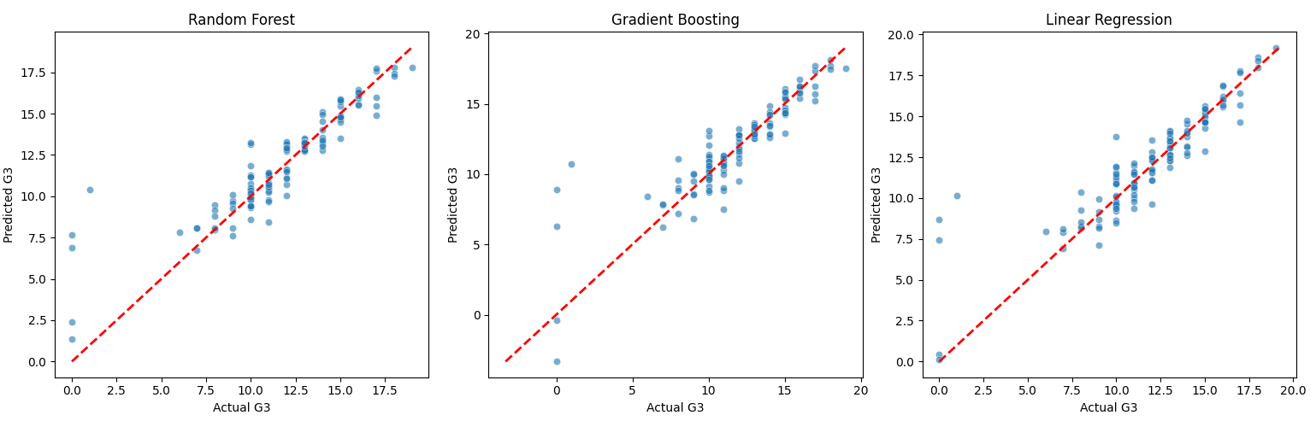

Slide 12
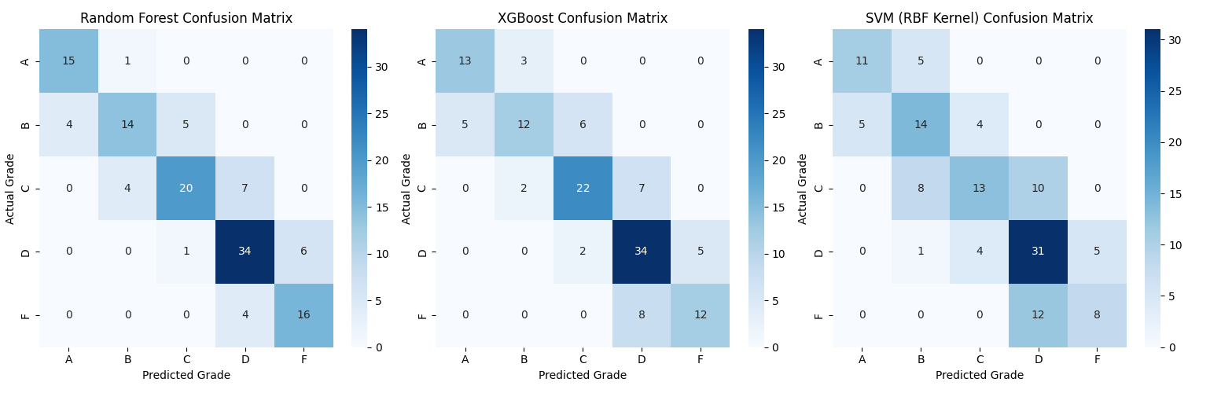

Slide 13
